Slide 1
CS 31006: Computer Networks – Transport Layer Services

Slide 2
Protocol Stack Implementation in a Host
Application
Software, Kernel
Transport
Network
Data Link
Firmware, Device Driver
Physical
Hardware

Slide 3
How Application Data Passes Through Different Layers
Application
HTTP Header
HTTP Data
Transport
TCP Header
Transport Layer Data
Network
IP Header
Network Layer Data
Data Link
MAC Header
Data Link Layer Data
Physical
PHY Header
MAC Header
IP Header
TCP Header
HTTP Header
HTTP Data
PHY Trailer

Slide 4
Transport Layer Services
UDP
TCP
End to end packet delivery
Connection Establishment
Reliable Data Delivery
Flow and Congestion Control
Ordered Packet Delivery
Transport
Datagram delivery (unreliable)
Network
Data Link

Slide 5
Connection Establishment
Client
Server
CONNECT
CONNECTION REQ
LISTEN
CONNECTION ACK
This is a simple primitive for connection establishment – but does this work good?

Slide 6
Connection Establishment
Consider a scenario when the network can lose, delay, corrupt and duplicate packets (the underline network layer uses unreliable data delivery)
Consider retransmission for ensuring reliability – every packet uses different paths to reach the destination
Packets may be delayed and got struck in the network congestion, after the timeout, the sender assumes that the packets have been dropped, and retransmits the packets

Slide 7
Connection Establishment
Client
Server
CONNECT
CONNECTION REQ - 1
LISTEN
It may happen that the server has crashed and reinitiated the connection. So distinguishing between these two is essential
CONNECTION REQ - 2
How will the server differentiate whether CONNECTION REQ-1 is a new connection request or a duplicate of the CONNECTION REQ-2?

Slide 8
Connection Establishment
Protocol correctness versus Protocol performance – an eternal debate in computer networks …
Delayed duplicates create a huge confusion in the packet switching network. A major challenge in packet switching network is to develop correct or at least acceptable protocols for handling delayed duplicates

Slide 9
Connection Establishment – Handling Delayed Duplicates
Solution 1: Use Throwaway Transport Address (Port Numbers)
Do not use a port number if it has been used once already – Delayed duplicate packets will never find their way to a transport process
Is this solution feasible?
Solution 2: Give each connection a unique identifier chosen by the initiating party and put in each segment
Can you see any problem in this approach?

Slide 10
Connection Establishment – Handling Delayed Duplicates
Solution 3: Devise a mechanism to kill off aged packets that are still hobbling about (Restrict the packet lifetime) – Makes it possible to design a feasible solution
Three ways to restrict packet lifetime
Restricted Network Design – Prevents packets from looping (bound the maximum delay including congestion)
Putting a hop count in each packet – initialize to a maximum value and decrement each time the packet traverses a single hop (most feasible implementation)
Timestamping each packet – define the lifetime of a packet in the network, need time synchronization across each router.
Design Challenge: We need to guarantee not only that a packet is dead, but also that all acknowledgements to it are also dead

Slide 11
Connection Establishment – Handling Delayed Duplicates
Let us define a maximum packet lifetime T – If we wait a time T secs after a packet has been sent, we can be sure that all traces of it (packet and its acknowledgement) are now gone
Rather than a physical clock (clock synchronization in the Internet is difficult to achieve), let us use a virtual clock – sequence number generated based on the clock ticks
Label segments with sequence numbers that will not be reused within T secs.
The period T and the rate of packets per second determine the size of the sequence number – at most one packet with a given sequence number may be outstanding at any given time

Slide 12
Sequence Number Adjustment
Two important requirements (Tomlinson 1975, Selecting Sequence Numbers)
Sequence numbers must be chosen such that a particular sequence number never refers to more than one byte (for byte sequence numbers) at any one time (how to choose the initial sequence number)
The valid range of sequence numbers must be positively synchronized between the sender and the receiver, whenever a connection is used (three way handshaking followed by the flow control mechanism – once connection is established, only send the data with expected sequence numbers)

Slide 13
Why Initial Sequence Number is Important
Conn 2 initialized
Conn 1 crashed
Connection 2
Sequence Numbers
Connection 1
Time
Packet Lifetime T
A Delayed duplicate packet of connection 1 can create a confusion for connection 2

Slide 14
What We Ideally Want? Or …
Conn 2 initialized
Conn 1 crashed
Sequence Numbers
Connection 2
Connection 1
Time
Packet Lifetime T

Slide 15
What We Ideally Want? Either …
Conn 2 initialized
Connection 2
Conn 1 crashed
Sequence Numbers
Connection 1
Time
Packet Lifetime T

Slide 16
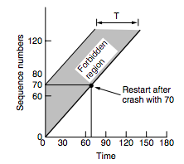
Connection Establishment – Handling Delayed Duplicates
If a receiver receives two segments having the same sequence number within a duration T, then one packet must be the duplicate. The receiver then discards the duplicate packets.
For a crashed device, the transport entity remains idle for a duration T after recovery, to ensure that all packets from the previous connection are dead – not a good solution
Adjust the initial sequence numbers properly - A host does not restart with a sequence number in the forbidden region, based on the sequence number it used before crash and the time duration T.

Slide 17
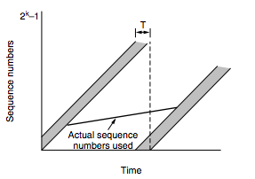
How do We Ensure that Packet Sequence Numbers are Out of the Forbidden Region
Two possible source of problems
A host sends too much data too fast on a newly opened connection
The data rate is too slow that the sequence number for a previous connection enters the forbidden region for the next connection
Source: Computer Networks (5th Edition) by Tanenbaum, Wetherell

Slide 18
Adjusting the Sending Rate based on Sequence Numbers
The maximum data rate on any connection is one segment per clock tick
Clock ticks (inter-packet transmission duration) is adjusted based on the sequences acknowledged – ensure that no two packets are there in the network with same sequence number
We call this mechanism as self-clocking (used in TCP)
Ensures that the sequence numbers do not warp around too quickly (RFC 1323)
We do not remember sequence number at the receiver: Use a three way handshake to ensure that the connection request is not a repetition of an old connection request
The individual peers validate their own sequence number by looking at the acknowledgement (ACK)
Positive synchronization among the sender and the receiver

Slide 19
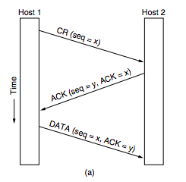
Three Way Handshake
By looking at the ACK, Host 1 ensures that Sequence number x does not belong to the forbidden region of any previously established connection
By looking at the ACK in DATA, Host 2 ensures that sequence number y does not belong to the forbidden region of any previously established connection
Source: Computer Networks (5th Edition) by Tanenbaum, Wetherell

Slide 20
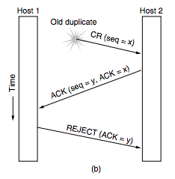
Three Way Handshake – CONNECTION REQUEST is a Delayed Duplicate
Source: Computer Networks (5th Edition) by Tanenbaum, Wetherell

Slide 21
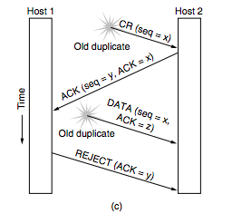
Three Way Handshake – CONNECTION REQUEST and ACKNOWLEDGEMENT both are Delayed Duplicates
Source: Computer Networks (5th Edition) by Tanenbaum, Wetherell

Slide 22
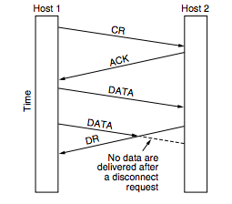
Connection Release – Asymmetric Release
When one party hangs up, the connection is broken
This may results in data loss
Source: Computer Networks (5th Edition) by Tanenbaum, Wetherell

Slide 23
Connection Release – Symmetric Release
Treats the connection as two separate unidirectional connections and requires each one to be released separately
Does the job when each process has a fixed amount of data to send and clearly knows when it has sent it.
What can be a protocol for this?
Host 1: “I am done”
Host 2: ”I am done too”
Does this protocol work good always?

Slide 24
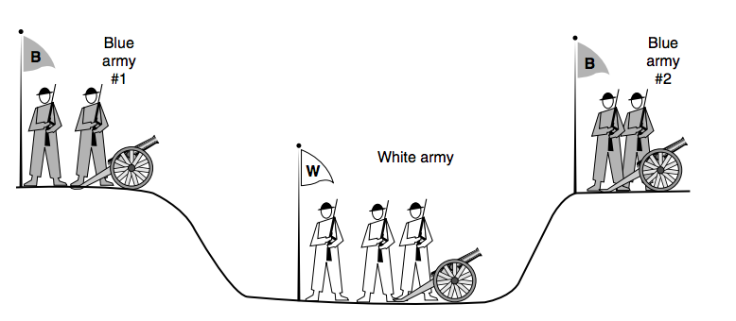
The Two Army Problem
Source: Computer Networks (5th Edition) by Tanenbaum, Wetherell
Let every party take independent decisions
No protocol exists to solve this

Slide 25
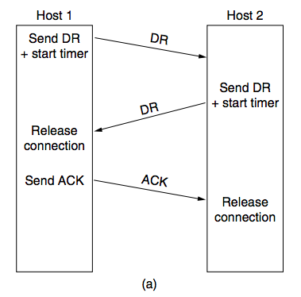
Connection Release
Source: Computer Networks (5th Edition) by Tanenbaum, Wetherell

Slide 26
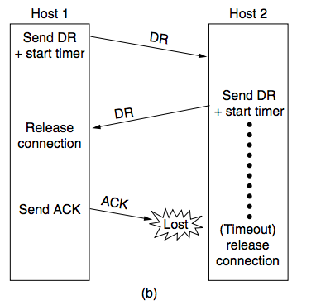
Connection Release – Final ACK Lost
Source: Computer Networks (5th Edition) by Tanenbaum, Wetherell

Slide 27
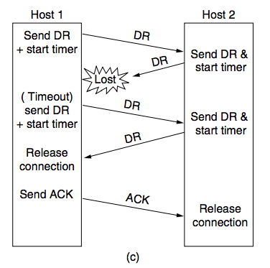
Connection Release – Response Lost
Source: Computer Networks (5th Edition) by Tanenbaum, Wetherell

Slide 28
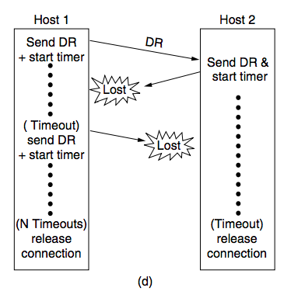
Connection Release – Response Lost and Subsequent DRs Lost
Source: Computer Networks (5th Edition) by Tanenbaum, Wetherell

Slide 29
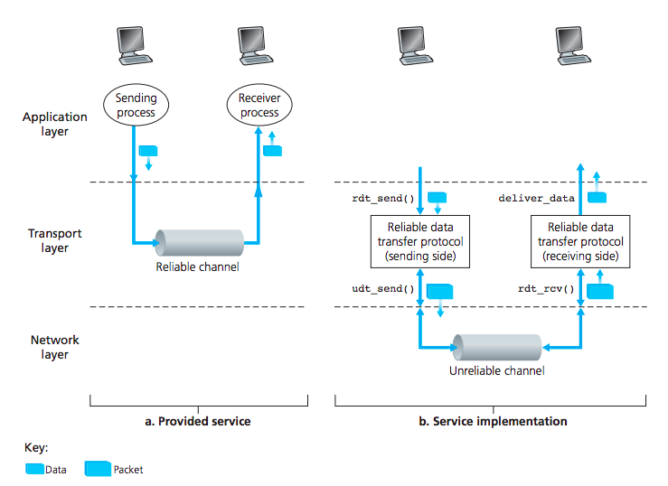
Ensure Reliability at the Transport Layer
Source: Computer Networks, Kurose, Ross

Slide 30
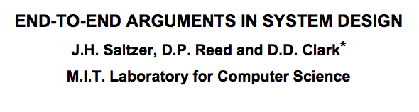
Error Control and Flow Control
These features are used in both Data Link Layer and Transport Layer – Why?
Flow control and error control at the transport layer is essential
Flow control and error control at the data link layer improves performance

Slide 31
Flow Control Algorithms
Stop and Wait Flow Control (Error Free Channel):

Slide 32
Flow Control Algorithms
Stop and Wait (Noisy Channel):
Use sequence numbers to individually identify each frame and the corresponding acknowledgement
What can be a maximum size of the sequence number in Stop and Wait?
Automatic Repeat Request (ARQ)

Slide 33
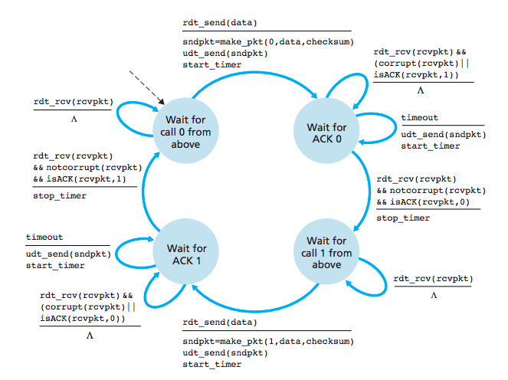
Stop and Wait ARQ – Sender Implementation
Source: Computer Networks, Kurose, Ross

Slide 34
Problem with Stop and Wait
Every packet needs to wait for the acknowledgement of the previous packet.
For bidirectional connections – use two instances of the stop and wait protocol at both directions – further waste of resources
A possible solution: Piggyback data and acknowledgement from both the directions
Reduce resource waste based on sliding window protocols (a pipelined protocol)

Slide 35
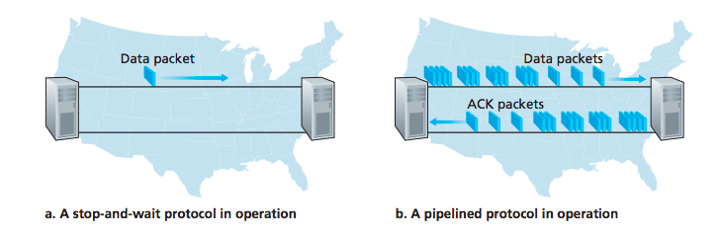
Stop and Wait versus Sliding Window (Pipelined)
Source: Computer Networks, Kurose, Ross

Slide 36
Sliding Window Protocols
Each outbound segment contains a sequence number – from 0 to some maximum (2^{n}-1 for a n bit sequence number)
The sender maintains a set of sequence numbers corresponding to frames it is permitted to send (sending window)
The receiver maintains a set of frames it is permitted to accept (receiving window)

Slide 37
Sliding Window Protocols – Sending Window and Receiving Window
Source: http://ironbark.xtelco.com.au/subjects/DC/lectures/13/

Slide 38
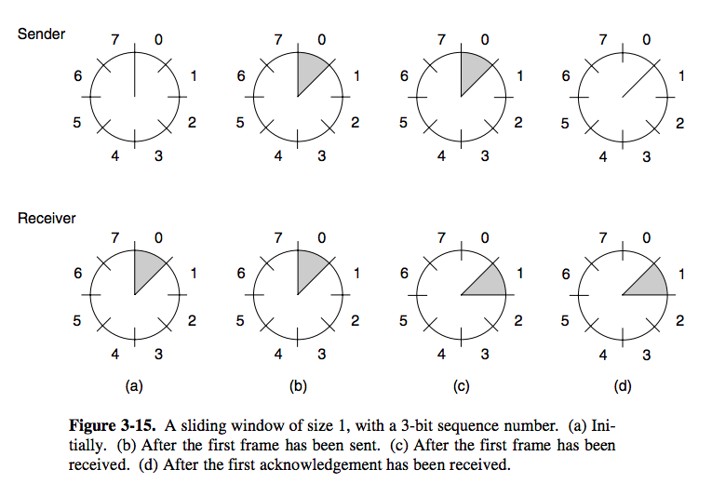
Sliding Window for a 3 bit Sequence Number
Source: Computer Networks (5th Edition) by Tanenbaum, Wetherell

Slide 39
Sliding Window Protocols in Noisy Channels
A timeout occurs if a segment (or the acknowledgment) gets lost
How does the flow and error control protocol handle a timeout?
Go Back N ARQ: If segment N is lost, all the segments from segment 0 (start of the sliding window) to segment N are retransmitted
Selective Repeat (SR) ARQ: Only the lost packets are selectively retransmitted
Negative Acknowledgement (NAK) or Selective Acknowledgements (SACK): Informs the sender about which packets need to be retransmitted (not received by the receiver)

Slide 40
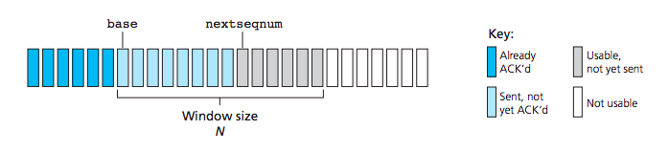
Go Back N ARQ – Sender Window Control
Source: Computer Networks, Kurose, Ross

Slide 41
Go Back N ARQ
Source https://www.tutorialspoint.com/data_communication_computer_network/data_link_control_and_protocols.htm

Slide 42
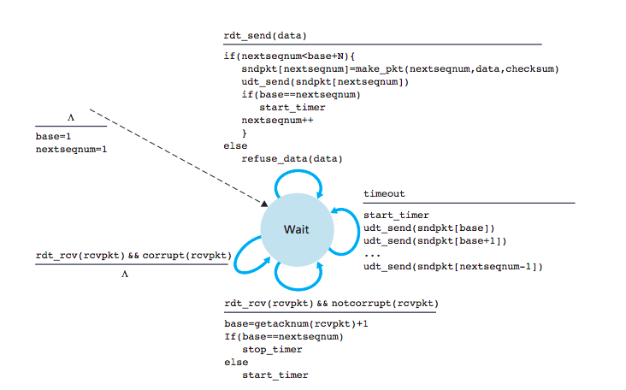
Go Back N ARQ – Sender
Source: Computer Networks, Kurose, Ross

Slide 43
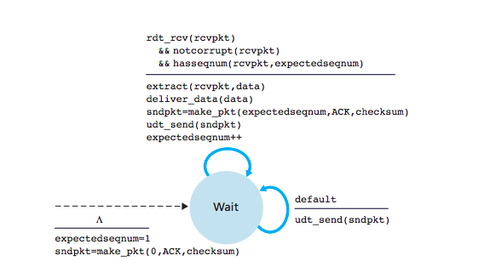
Go Back N ARQ – Receiver
Source: Computer Networks, Kurose, Ross

Slide 44
Go Back N ARQ – A Bound on Window Size
Outstanding Frames – Frames that have been transmitted, but not yet acknowledged
Maximum Sequence Number (MAX_SEQ): MAX_SEQ+1 distinct sequence numbers are there
0,1,…,MAX_SEQ
Maximum Number of Outstanding Frames (=Window Size): MAX_SEQ
Example: Sequence Numbers (0,1,2,…,7) – 3 bit sequence numbers, number of outstanding frames = 7 (Not 8)

Slide 45
Go Back N ARQ – A Bound on Window Size
Let MAX_SEQ = 3, Window Size = 4
0
0
1
2
3
0
0
1
2
3
0
0
1
2
3
0
1
0
1
2
3
0
0
1
2
3
0
2
0
1
2
3
0
3
0
1
2
3
0
0
1
2
3
0
Timeout
0
1
2
3
0
0
0
1
2
3
0

Slide 46
Go Back N ARQ – A Bound on Window Size
Let MAX_SEQ = 3, Window Size = 3
0
0
1
2
3
0
0
1
2
3
0
0
1
2
3
0
1
0
1
2
3
0
0
1
2
3
0
2
0
1
2
3
0
Timeout
0
0
1
2
3
0
0
1
2
3
0
Discards the wrong frame correctly

Slide 47
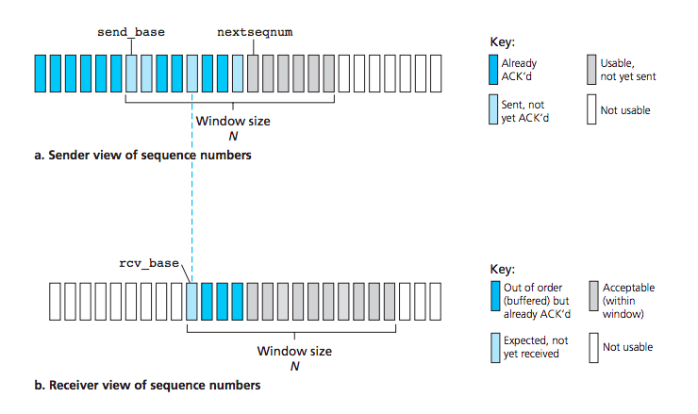
Selective Repeat (SR) – Window Control
Source: Computer Networks, Kurose, Ross

Slide 48
Selective Repeat ARQ

Slide 49
Selective Repeat – A Bound on Window Size
Maximum Sequence Number (MAX_SEQ): MAX_SEQ+1 distinct sequence numbers are there
0,1,…,MAX_SEQ
Maximum Number of Outstanding Frames ( =Window Size ): (MAX_SEQ+1)/2
Example: Sequence Numbers (0,1,2,…,7) – 3 bit sequence numbers, number of outstanding frames (window size) = 4

Slide 50
Selective Repeat – A Bound on Window Size
Let MAX_SEQ = 3, Window Size = 3 [(MAX_SEQ+1)/2+1]
0
0
1
2
3
0
0
1
2
3
0
1
2
0
1
2
3
0
1
0
1
2
3
0
1
2
0
1
2
3
0
2
0
1
2
3
0
1
2
Timeout
0
0
1
2
3
0
0
1
2
3
0
1
2

Slide 51
Selective Repeat – A Bound on Window Size
Let MAX_SEQ = 3, Window Size = 2
0
0
1
2
3
0
0
1
2
3
0
1
2
0
1
2
3
0
1
0
1
2
3
0
1
2
Timeout
0
1
2
3
0
0
0
1
2
3
0
1
2
Discards the wrong frame correctly

Slide 52
Bandwidth Delay Product
Bandwidth Delay Product (BDP) = Link Bandwidth x Link Delay – an important metric for flow control
Consider Bandwidth = 50 Kbps, one way transit time (delay) = 250 msec
BDP 12.5 Kbit
Assume 1000 bit segment size; BDP = 12.5 segments
Consider the event of a segment transmission and the corresponding ACK reception – this takes a round trip time (RTT) – twice the one way latency.
Maximum number of segments that can be outstanding during this duration = 12.5 x 2 = 25 segments

Slide 53
Bandwidth Delay Product – Implication on Window Size
Maximum number of segments that can be outstanding within this duration = 25 + 1 (as the ACK is sent only when the first segment is received) = 26
This gives the maximum link utilization – the link will always be busy in transmitting data segments
Let BD denotes the number of frames equivalent to the BDP, w is the maximum window size
So, w = 2BD + 1 gives the maximum link utilization – this is an important concept to decide the window size for a window based flow control mechanism

Slide 54
Implication of BDP on Protocol Design Choice
Consider the link bandwidth = 1Mbps, Delay = 1ms
Consider a network, where segment size is 1 KB (1024 bytes)
Which protocol is better for flow control?
(a) stop and wait,
(b) Go back N,
(c) Selective Repeat
BDP = 1 Mbps x 1ms = 1 Kb (1024 bits)
The segment size is eight times larger than the BDP -> the link can not hold an entire segment completely
Sliding window protocols do not improve performance
Stop and Wait is better – less complexity

Slide 55
Application Transport Interfacing – Sender Side
APPLICATION
USER
write(), send()
Trigger Periodically
Transmission Rate Control
KERNEL
TportSend()
Send Data to IP
Function names are hypothetical

Slide 56
Application Transport Interfacing – Sender Side
APPLICATION
Different connections are treated differently, so we need connection specific source buffering
USER
write(), send()
Trigger Periodically
Transmission Rate Control
KERNEL
TportSend()
write() call blocks the port until the complete data is written in the transport buffer
Transport Buffer - Sender
Send Data to IP
Function names are hypothetical

Slide 57
Application Transport Interfacing – Receiver Side
APPLICATION
read() call blocks the port until the data is received and the complete data is read from the transport buffer
USER
read(), recv()
Function names are hypothetical
KERNEL
Interrupt
CheckBuffer()
TportRecv()
Data from IP
Transport Buffer - Receiver

Slide 58
Application Transport Interfacing – Receiver Side (Alternate Implementation)
APPLICATION
USER
read(), recv()
Function names are hypothetical
KERNEL
get()
poll()
PollBuffer()
TportRecv()
Data from IP
Transport Buffer - Receiver

Slide 59
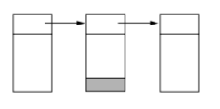
Organizing Transport Buffer Pool
If most segments are nearly the same size, organize the buffer as a pool of identically sized buffers (one segment per buffer)
For variable segment size – chained fixed sized buffer (buffer size = maximum segment size)
Space would be wasted if segment sizes are widely varied
Small buffer size – multiple buffers to store a single segment – added complexity in implementation

Slide 60
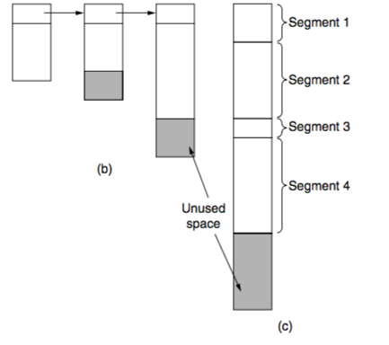
Organizing Transport Buffer Pool
Variable size buffers (b)
Advantage: better memory utilization
Disadvantage: Complicated implementation
Single large circular buffer for every connection (c)
Good use of memory only when connections are heavily loaded
Source: Computer Networks (5th Edition) by Tanenbaum, Wetherell

Slide 61
Dynamic Buffer Management for Window Based Flow Control
Sender and receiver needs to dynamically adjust buffer allocations
Based on the rate difference between the receive rate by the transport entity and the receive rate by the application, the available size of the receiver buffer changes
Sender should not send more data compared to receiver buffer space – dynamically adjust the window size based on availability of receiver buffer space
Segments awaiting at the buffer
Segments read by the application
Free Space at Receiver Buffer

Slide 62
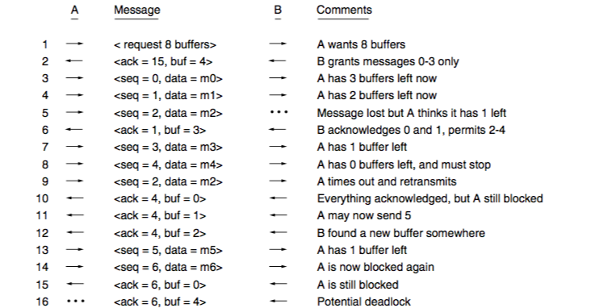
Dynamic Buffer Management for Window Based Flow Control
Receiver forwards available buffer space through ACK
Ensure that the ACKs are flowing in the network continously

Slide 63
Congestion Control in the Network
Consider a centralized network scenario – how can you maintain optimal flow rates?
6
5
18
10
2
50
50
D
S
2
20
11
4
Apply Max Flow Min Cut Theorem !
But this is hard in a real network …

Slide 64
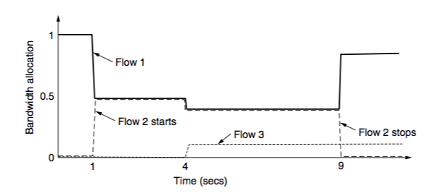
Congestion Control in the Network
Source: Computer Networks (5th Edition) by Tanenbaum, Wetherell
Changing Bandwidth Allocation over Time

Slide 65
Congestion Control in the Network
Flows enter and exit network dynamically – so applying an algorithm for congestion control is difficult
Congestion avoidance: Regulate the sending rate based on what the network can support
Sending Rate = minimum (network rate, Receiver rate)
Gradually increase the network rate and observe the effect on flow rates (packet loss)
Comes from flow control – receiver advertised window size for a sliding window flow control

Slide 66
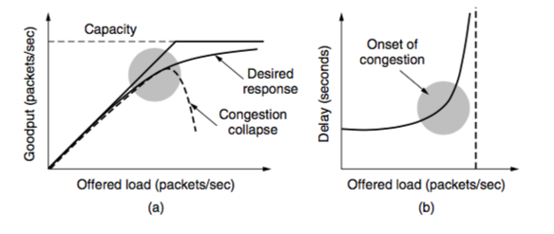
Network Congestion – Impact over Goodput and Delay
Source: Computer Networks (5th Edition) by Tanenbaum, Wetherell

Slide 67
Congestion Control and Fairness
Ensure that the rate of all the flows in the network is controlled in a fair way
A bad congestion control algorithm may affect fairness - Some flows can get starved
Hard fairness in a decentralized network is difficult to implement
Max-Min Fairness: An allocation is max-min fair if the bandwidth given to one flow cannot be increased without decreasing the bandwidth given to another flow with an allocation.

Slide 68
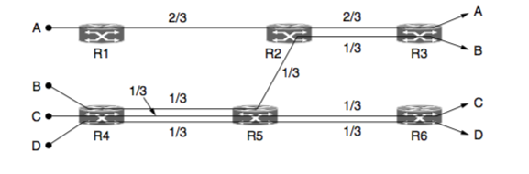
Max-Min Fairness – An Example
Source: Computer Networks (5th Edition) by Tanenbaum, Wetherell

Slide 69
AIMD – Efficient and Fair Operating Point for Congestion Control
Additive Increase Multiplicative Decrease (AIMD) – Chiu and Jain (1989)
Let w(t) be the sending rate. a (a > 0) is the additive increase factor, and b (0<b<1) is the multiplicative decrease factor

Slide 70
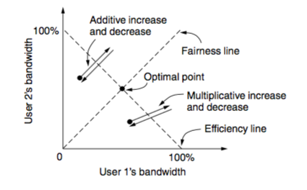
AIMD – Design Rationale (Two Flows Example)
AIAD – Oscillate across the efficiency line
MIMD – Oscillate across the efficiency line (different slope from AIAD)
Source: Computer Networks (5th Edition) by Tanenbaum, Wetherell

Slide 71
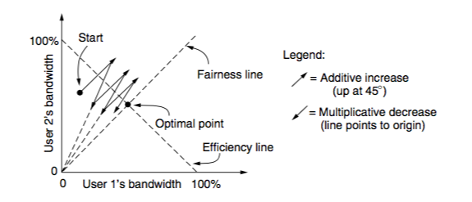
AIMD – Design Rationale (Two Flows Example)
The path converges towards the optimal point
Used by TCP - Adjust the size of the sliding window to control the rates
Source: Computer Networks (5th Edition) by Tanenbaum, Wetherell

Slide 72
Let us look TCP design details …

